Slide 1

Sylvan Hills Middle School

Slide 2
Norms
This is a meeting of the GO Team. Only members of the team may participate in the discussion. Any members of the public present are here to quietly observe.
We will follow the agenda as noticed to the public and stay on task.
We invite and welcome contributions of every member and listen to each other.
We will respect all ideas and assume good intentions.

Slide 3

GO Team Budget Development Process
SHMS STRATEGIC PLAN
Sylvan Hills Middle School will provide a nurturing and safe environment where scholars will become critical thinkers, problem solvers, lifelong learners, and productive citizens.
Step 1: Data Review
Step 2: Strategic Plan Review
Step 3: Budget Parameters
Step 4: Budget Choices

Slide 4
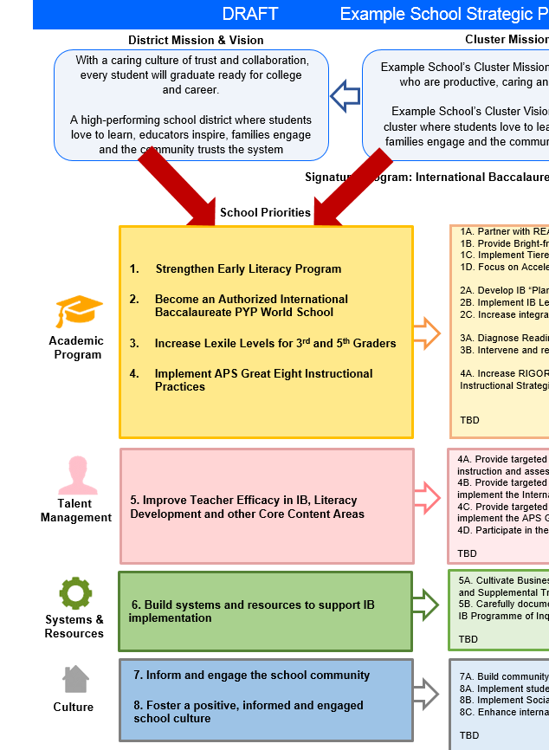
FY21 Budget Development Process
Principal’s Role
Design the budget and propose operational changes that can raise student achievement
Flesh out strategies, implement and manage them at the school level
Focus on the day-to-day operations
Serve as the expert on the school
Hire quality instructional and support personnel
The GO Team’s Role:
Focus on the big picture (positions and resources, not people)
Ensure that the budget is aligned to the school’s mission and vision and that resources are allocated to support key strategic priorities

Slide 5
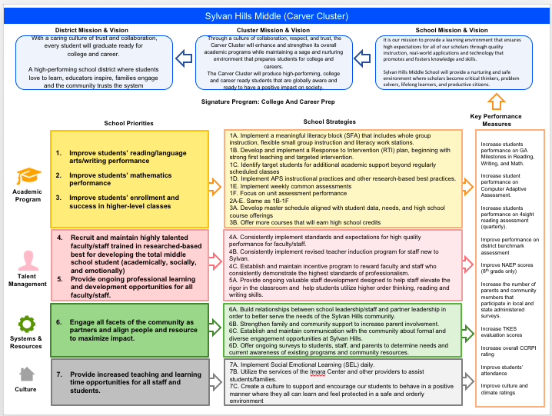

Sylvan Hills Middle Strategic Plan
Notes:
You should have a copy of our updated strategic plan (please make copies to be distributed to team).

Slide 6

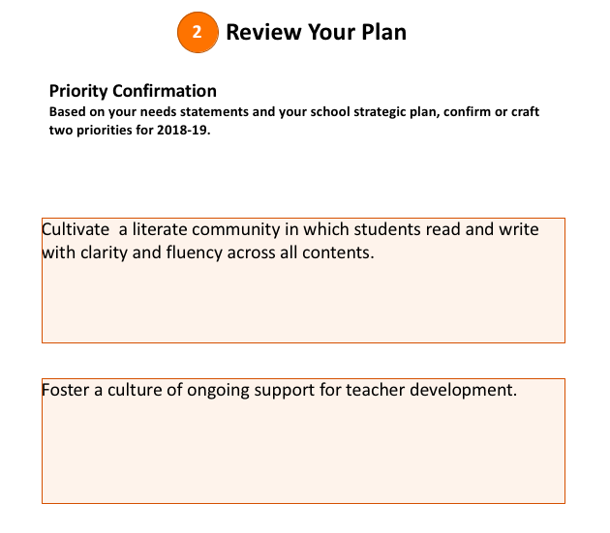
SCHOOL PRIORITIES

Slide 7
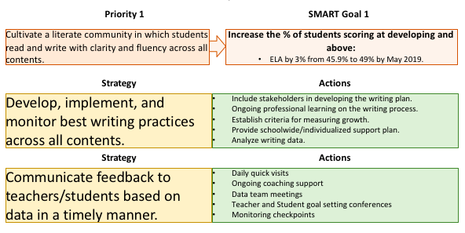
Strategies for Priority #1
GOAL: 3% increase

Slide 8
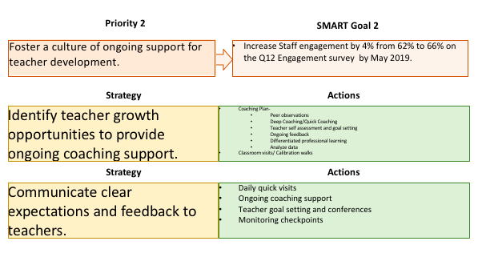
Strategies for Priority #2
Increase performance on Q12 Engagement Survey
GOAL: 4% increase

Slide 9
FY21 Budget Parameters
FY20 School Priorities | Rationale
Cultivate a literate community in which students read and write with clarity and fluency across the curriculum | Students are showing success in Literacy as evidenced by increased Lexile scores, assessment data, and daily classwork in English Language Arts classes but all other core content areas are not showing evidence of success especially in students showing evidence of knowledge of standards in written explanations
Foster a culture of ongoing support for teacher development. | We will work to support and retain an energized and inspired team of teachers who are capable of advancing ever-increasing levels of achievement for all students.
Manage systems & resources to ultimately impact student achievement positively. | We will improve efficiency (productivity, cost, etc.) while also making decisions (including resource allocations) that are grounded in a strategic academic direction and data.
Sustain a positive culture that welcomes stakeholders to invest and commit to a student centered school and community. | We will continue to build trust with the community, and we will have engaged stakeholders (employees, students, parents, community members, partners, etc.) who are invested in the mission and vision and who support the creation of student-centered learning communities.

Slide 10
STAR READING
 | 6th Grade |  | 7th Grade |  | 8th Grade
 | FALL | WTR | FALL | WTR | FALL | WTR
Beginning | 50% | 53% | 46% | 47% | 38% | 37%
Developing | 38% | 38% | 37% | 37% | 44% | 47%
Proficient | 11% | 9% | 16% | 15% | 18% | 15%
Distinguished | 1% | 1% | 1% | 1% | 0% | 1%

Slide 11
STAR READING
SWD
 | 6th Grade |  | 7th Grade |  | 8th Grade
 | FALL | WTR | FALL | WTR | FALL | WTR
Beginning | 83% | 67% | 92% | 93% | 92% | 80%
Developing | 17% | 33% | 1% | 1% | 4% | 16%
Proficient | 0% | 0% | >1% | 1% | 4% | 4%
Distinguished | 0% | 0% | 0% | 0% | 0% | 0%

Slide 12
STAR MATH
 | 6th Grade |  | 7th Grade |  | 8th Grade
 | FALL | WTR | FALL | WTR | FALL | WTR
Beginning | 49% | 36% | 35% | 27% | 49% | 30%
Developing | 44% | 44% | 45% | 37% | 41% | 44%
Proficient | 7% | 18% | 18% | 26% | 7% | 20%
Distinguished | 0% | 1% | 1% | 9% | 3% | 7%

Slide 13
STAR Math
SWD
 | 6th Grade |  | 7th Grade |  | 8th Grade
 | FALL | WTR | FALL | WTR | FALL | WTR
Beginning | 81% | 71% | 85% | 81% | 96% | 75%
Developing | 14% | 25% | 12% | 15% | 4% | 25%
Proficient | 5% | 4% | 4% | 4% | 0% | 0%
Distinguished | 0% | 0% | 0% | 0% | 0% | 0%

Slide 14
Discussion of Budget Summary
(Step 4: Budget Choices)

Slide 15
Principal’s Summary
This budget represents an investment plan for our school’s students, employees and the community as a whole.
The budget recommendations are tied directly to the school’s strategic vision and direction.
The proposed budget for the general operations of the school are reflected at $6, 201, 675.
This investment plan for FY21 accommodates a student population that is projected to be 525 students, which is a decrease of 81 students from FY20.

Slide 16
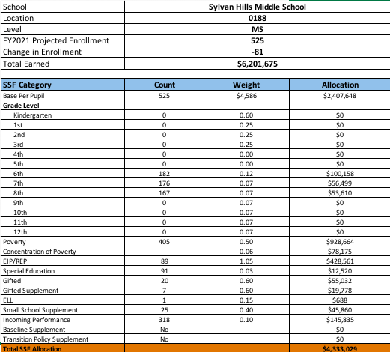
School Allocation

Slide 17
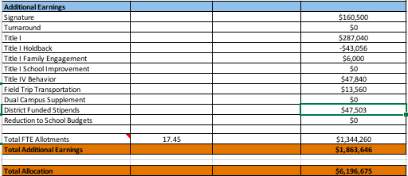
School Allocation Cont.

Slide 18
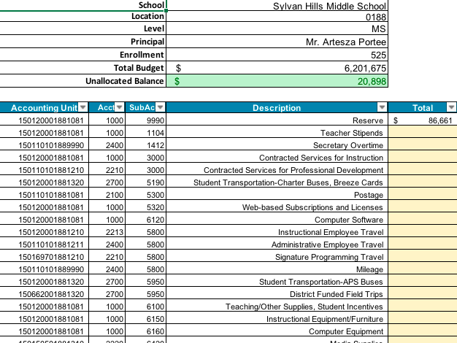
Budget by Function

Slide 19
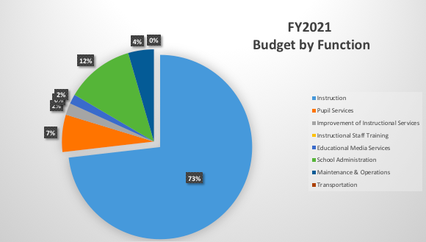
Budget by Function (Required)

Slide 20
What’s Next?
January:
  GO Team Initial Budget Session (Jan. 22nd-31st)
February:
  One-on-one Associate Superintendent discussions
  Cluster Planning Session (positions sharing, cluster alignment, etc.)
  Program Manager discussions and approvals
  GO Team Feedback Session
  HR Staffing Conferences (February 25th - March 1st)
• March:
  Final GO Team Approval (March 1st - March 15th)

Slide 21

Questions?
Thank you for your time and attention.

